Slide 1
AGENCY HOSTS
UP SYSTEM UP Diliman
UP Open University
UP Manila
UP PGH
UP Los Banos

Slide 2
Q2 Special Sub-cluster meeting June 30, 2015 UP-ISSI Diliman, QC

Slide 3
AGENDA
PRELIMINARIES
Prayer
National Anthem
Welcome
Agenda
Part I. New MC’s
Part II. Elements of SPMS
OPCR
Performance Standards
IPCR
Coaching Module

Slide 4
2015 Memorandum Circulars
MC No. 01. s.2015 - Display of the 2015 Search for Outstanding Public Officials and Employees Banners
MC No. 02, s.2015 - PRAISE Winners as Nominees to the 2015 Search for Outstanding Public Officials
MC No. 03, s. 2015 - Amendment to CSC MC No. 2, s. 2013 (Revised SALN Form)
MC No. 04, s. 2015 - 2015 National Women's Month Celebration
MC No. 05, s. 2015 - Dissemination and Adoption of the "10 KUMAINMENTS"
MC No. 06, s. 2015 - Public Sector HR Symposium and PSTD National Convention
MC No. 07, s. 2015 - Policy Governing the Filing and Taking of Civil Service Examinations of Those Holding Dual Citizenship
MC No. 08, s. 2015 - Grant of Foreign School Honor Graduate Eligibility to Filipino Honor Graduates of Bachelor's Degree in Foreign Schools
MC No. 09, s. 2015 - 115th Anniversary of the Philippine Civil Service

Slide 5
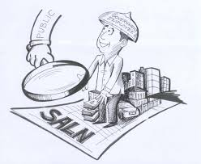
MC 3, 2015- Amendment to CSC MC No. 2, s. 2013 (Revised SALN Form)

Slide 6
MC 3, 2015

Slide 7
Mc 7, 2015

Slide 8
MC 9, 2015

Slide 9
MC 9, 2015

Slide 10
Office Performance & Commitment Review (OPCR) Form

Slide 11
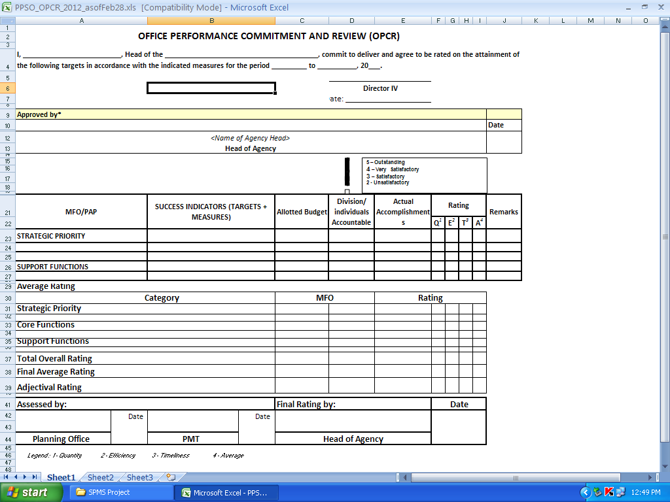

Slide 12
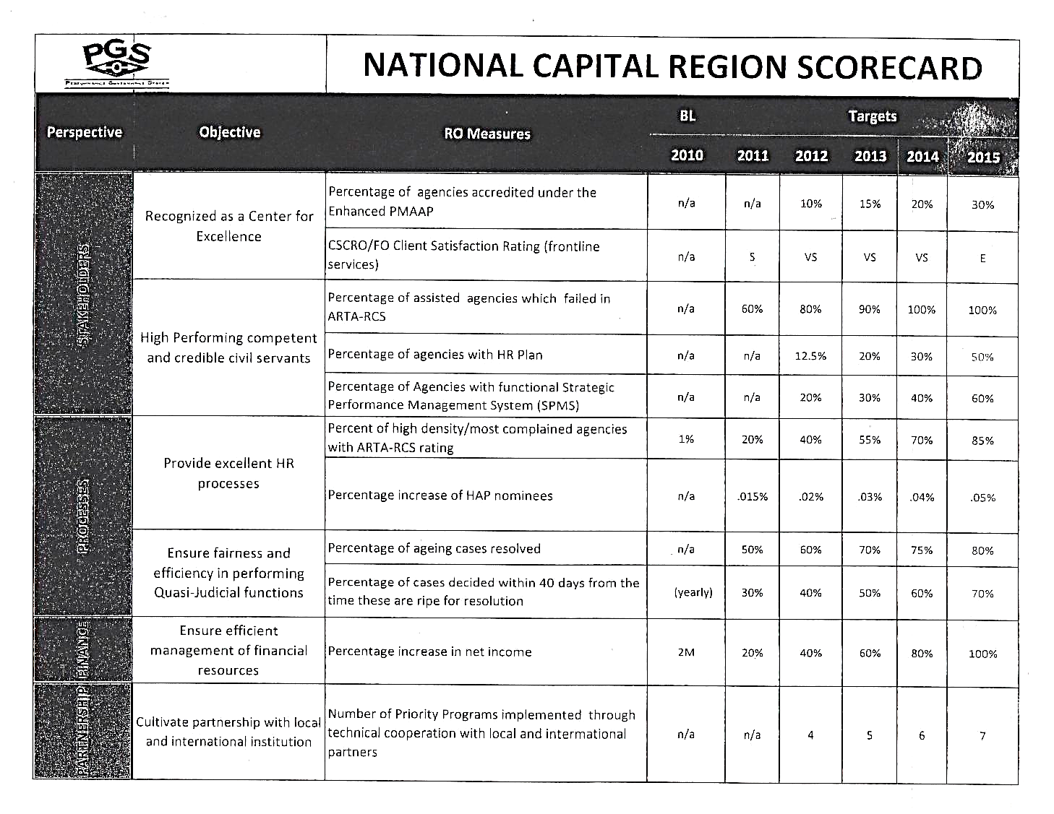

Slide 13
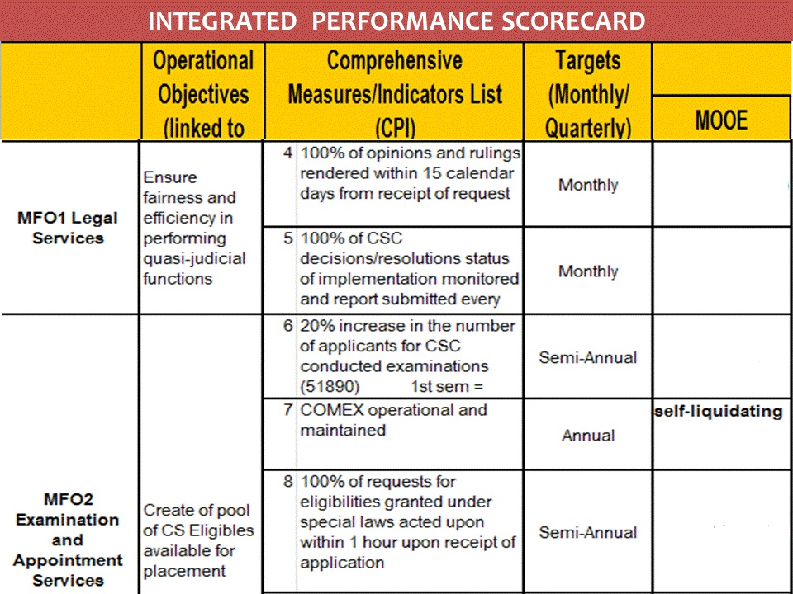
(430,332.32)
chargeable against trust fund
26,341.00
(170,253.89)
chargeable against trust fund
(112, 797.18)
chargeable against trust fund

Slide 14
All heads of offices shall accomplish their respective OPCRs
OPCRs must officially identify and declare the targets for the rating period
OPCRs must be in accordance with the over-all strategy map and commitments of the agency
Once these are reviewed and finalized by the PMT, all OPCRs must be signed and approved by the contracting parties
Upon approval of the OPCRs, these shall be cascaded to all employees for their reference in the preparation of the Individual Performance Commitment Review (IPCR) forms
All OPCRs must also detail the Success Indicators (SI) for all strategic/core/support objectives targeted for specific rating period

Slide 15
SIs are pre-set standards of work outputs or accomplishments consisting of:
(1) performance measures (key performance indicators, key performance measures)
(2) performance targets for each performance measure
(3) possible scenarios of outputs/accomplishments pertinent to tasks, initiatives, projects and programs to be undertaken
(4) corresponding scores/marks for these predicted scenarios
As much as possible, all possible scenarios must be considered and given equivalent score/mark in the determination of the SIs.

Slide 16
General Rules
In OPCR, the office shall compute the budget per program/project by expense account to ensure that budget allocation is strategy driven
The Office shall also identify specific division/unit/group and individual as primarily accountable for producing a particular target output per program/project/activity
Amendments to the OPCR may be allowed during the rating period to accommodate legitimate intervening tasks/ad hoc tasks and other superseding tasks subject to review of the concerned PMT and approval of top management

Slide 17
Individual Performance & Commitment Review (IPCR) Form

Slide 18
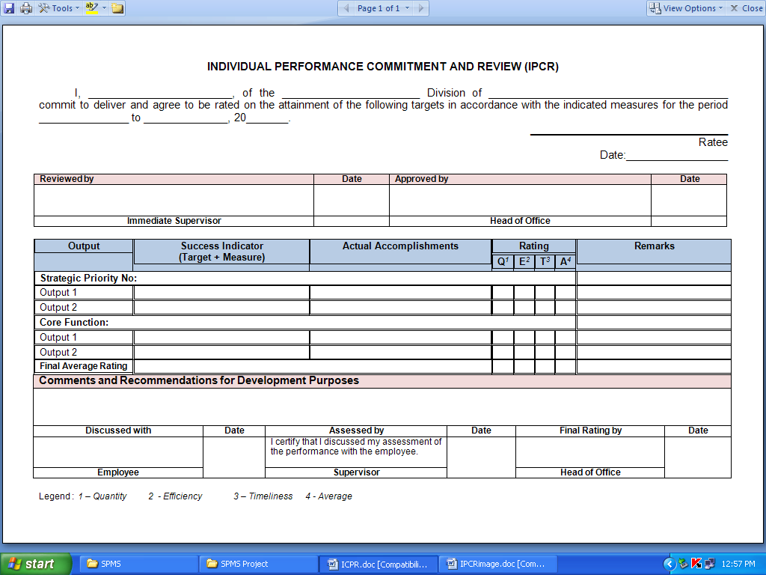

Slide 19
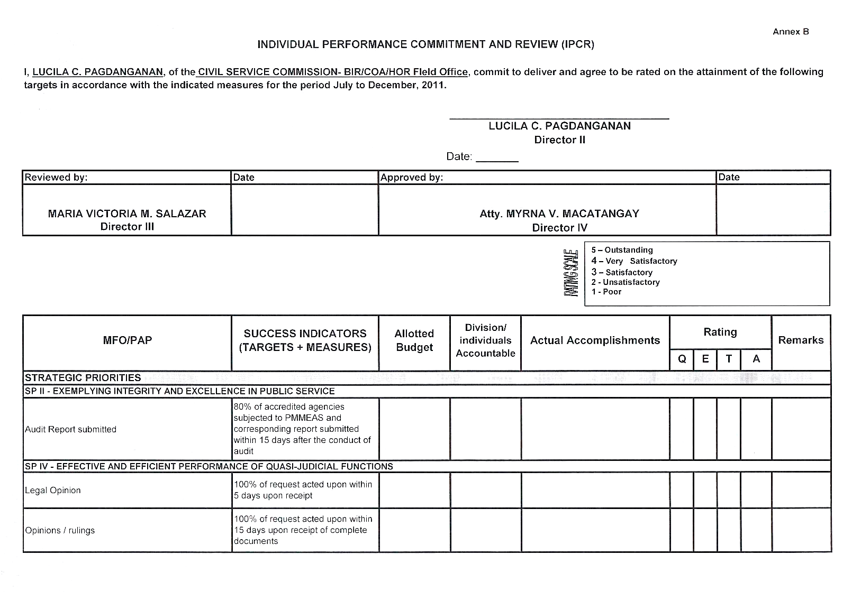

Slide 20
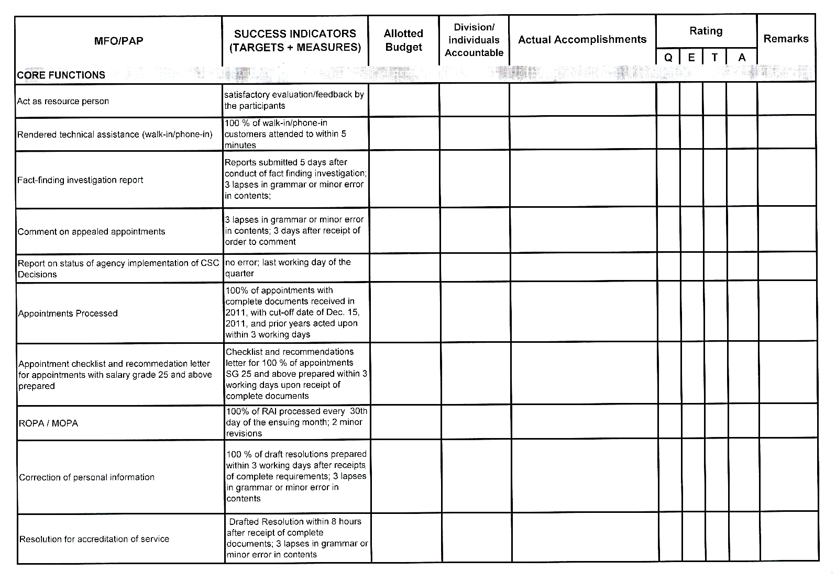

Slide 21
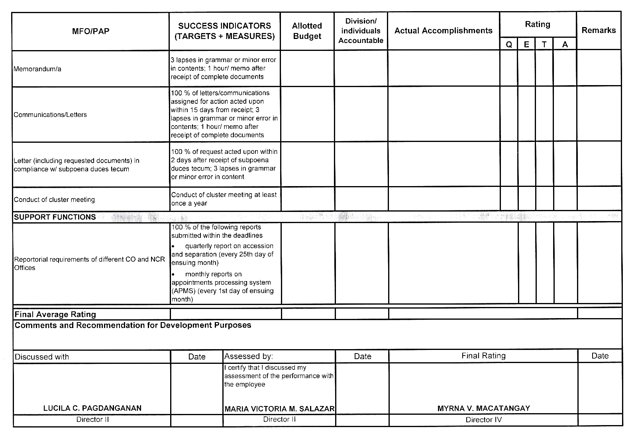

Slide 22
All employees shall accomplish their respective IPCR to establish the individual performance commitments for the rating period in accordance with the targets contained in their respective OPCRs
The IPCRs must contain the SIs for all strategic/core/support targeted for the rating period by the employee corresponding to the parameters of his/her respective supervisor’s OPCR

Slide 23
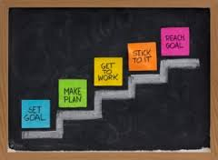
These SIs shall serve as basis for the individual employee’s scoring of performance outputs and accomplishments
Upon finalization of the IPCR, the employee and the supervisor shall sign the document to establish that the performance targets indicated therein were discussed and mutually agreed upon
The employee shall only sign the IPCR when prior discussions and agreements with his/her supervisor have been made

Slide 24
General Rules
All employees must submit their respective IPCRs within the timeline set by PMT, specifically before the start of a particular rating period
Non-submission of IPCR carries administrative sanctions pursuant to provisions of CSC-MC 6, 2012

Slide 25
Ratings Dimensions & Ratings Matrix

Slide 26
”What gets measured
gets done”
- Peter Drucker

Slide 27
What is Rating Dimension?
Under SPMS, there are 3 dimensions that must be used to measure each and every Success Indicator.
These 3 dimensions are Efficiency, Timeliness and Quality (E-T-Q)
However, some agencies also use the dimension of Quantity (Q) as accepted and independent dimension especially for some targets

Slide 28
Roles & Responsibilities
PMT
Sets consultation meetings with all Heads of Offices to discuss the office performance commitment and rating system and tools.
Ensures that office performance management targets, measures, and budget are aligned with those of goals of the agency.
Recommends approval of the office performance and rating system and tools.
Acts as appeals body and final arbiter.
Identifies potential top performers for awards.
Adopts its own internal rules, procedures, and strategies to carry out its responsibilities

Slide 29
Determining Performance Measures
Quantity/Efficiency – percentage, quota, number of reports, number of MOAs signed, amount of collections, number of employees oriented
Timeliness – turnaround time (in minutes, hours, days, months, etc.), cycle time, claim processing time, response time, target date or deadline, product development rate, delivery time, etc.
Quality/Effectiveness – customer satisfaction rate, employee satisfaction rate, employee engagement index, capability index, customer positive feedback, quality hire, ARTA compliance
Performance Measures need not be many. Only those that contribute to or support the outcomes that the organization aims to achieve shall be included in the OPCR

Slide 30
General Rules
Under SPMS, not all SIs have to be measured using all the available dimensions
The use and appropriate application of rating dimension for each SI depends on the nature of the targets, to be reviewed and approved by the Head of Office and concurred by the PMT
Thus, there are SIs that carry only 1 dimension or 2 dimensions or all dimensions depending on the final discussions and agreements of concerned parties, including PMT

Slide 31
Determining Targets
Address the need of the identified customer/s (internal or external) of the office and/or equivalent to (if not exceeding) the customer’s expectations
Be aligned and synchronized with the strategic goals and objectives of the agency
Be higher than what was achieved during the previous appraisal period (for previous achievements which were not yet the highest targets to be possibly achieved
Be challenging enough to raise the bar of agency’s performance excellence
Consider the resources available and the geographical, environmental and cultural/societal limitations of the office
Reinforce and foster the culture of teamwork among individuals and work units

Slide 32
Sources of Targeting
Historical data
Benchmarking
Client Demand
Targets from past PMS (OPES, PES, etc)
Management Instructions
Future Trend

Slide 33
Sample performance standards

Slide 34
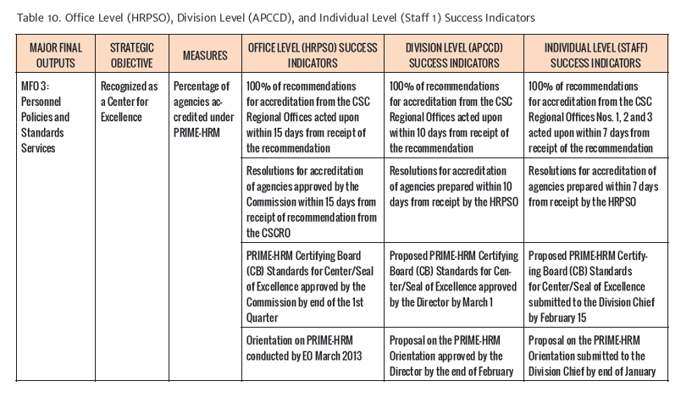

Slide 35
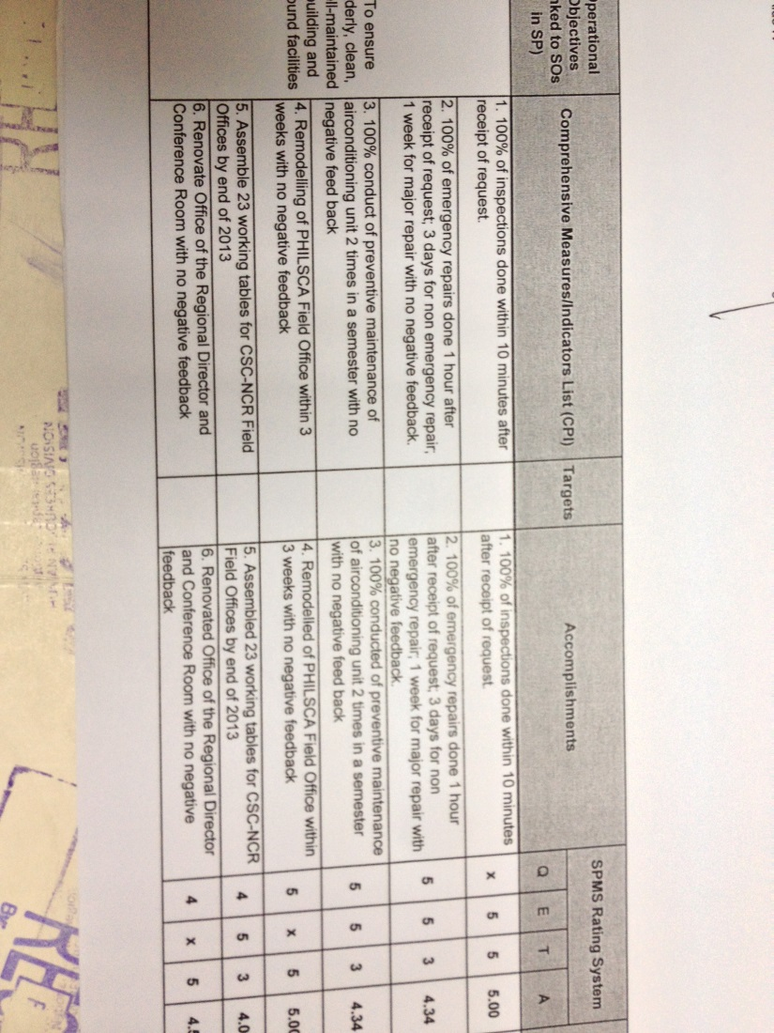

Slide 38
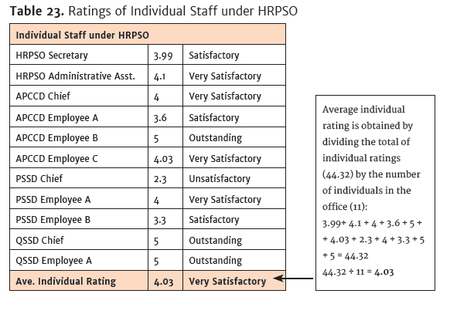

Slide 39
Rating Scale
Rating |  | Description
Numerical | Adjectival
5 | Outstanding | Extraordinary level of achievement Exceptional job mastery in all major areas of responsibility have demonstrated Marked excellence of achievement and contributions to the organization
4 | Very Satisfactory | Exceeded expectations All goals, objectives and targets were achieved above standards
3 | Satisfactory | Met expectations Most critical annual goals are met
2 | Unsatisfactory | Failed to meet expectations One or more of the most critical goals were not met
1 | Poor | Consistently below expectations Reasonable progress toward critical goals was not made

Slide 40
Rating Ranges (CSC-MC No. 13, series of 1999)
Outstanding (5) = 130 % and UP
Very Satisfactory (4) = 115 % to 129 %
Satisfactory (3) = 100 % - 114 %
Unsatisfactory (2) = 99 % - 51 %
Poor (1) = 50 % and BELOW

Slide 41
General Rules
Historically used and validated in past CSC performance management systems
Harmonized with the rating ranges of the Results-Based Performance Management System (RBPMS) as adopted by the Inter-Agency Task Force on RBPMS
This may not be applied as “absolute” rule (hard and fast rule) for all SIs especially for targets adhering to existing laws, rules, regulations and guidelines
At the end of the day, the determination of rating ranges per SI depends on the appreciation and decisions by PMT to protect the integrity, validity and sanctity of each performance target

Slide 42
Monitoring & Coaching Journal (MCJ)

Slide 43
Regular monitoring of employee’s performance is mandatory under SPMS
It is the responsibility of every Head of Office, the Planning Office, the Human Resource Department as well as the whole PMT to ensure that a sustainable monitoring mechanism is in place and functional during the SPMS implementation
This could be done on a weekly, monthly or quarterly prior to the 3rd cycle of the SPMS to protect the integrity and sanctity of the accomplishments
This facilitates easy tracking of progress on all identified targets vis-à-vis the performance of individual employee

Slide 44
Role of the Manager/Leader
Monitors the work activities or accomplishments of employees on regular basis (monthly, quarterly, semi-annually, etc)
Addresses the factors that either help or hinder effective work performance
Designs tracking tools or monitoring strategies
Acts as enabler/coach/mentor rather than a mere evaluator
video

Slide 45
Purpose
Timely steps are taken to keep targets on track
Office goals are met in the most effective manner
Necessary support systems and resources are provided
Enabling environment is fostered to improve team performance
Employees’ potentials are managed, developed and maximized

Slide 46
Monitoring/Coaching Journal
All supervisors must maintain a journal using the MCJ Form to record the conduct of monitoring and coaching which shall contain the following:
Date of the monitoring/coaching moment
Brief Statement or Purpose of the monitoring/coaching
Name of person/coachee
Critical incidents discussed
Agreements/actions taken/next steps
Both the coach and the coachee shall affix their signatures in the space provided by the form

Slide 47
COACHING IS...
Helping someone achieve goals
Helping find solutions
Sometimes about helping them understand what is holding them back so that they can find a way forward
Its success depends on the coaches believing in the coachee to find the best solutions for themselves

Slide 48
COACHING OBJECTIVES
To STOP doing what
one should not be
doing!
Notes:
48

Slide 49
COACHING OBJECTIVES
To START doing what one should be doing!
Notes:
49

Slide 50
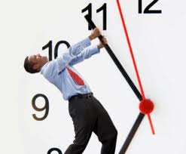
REASONS WHY MANAGERS AVOID COACHING
1. Lack of Time
Notes:
50

Slide 51
2. Fear of Failure
Notes:
51

Slide 52
3. Desire not to scare or overwhelm a new
employee
Notes:
52

Slide 53
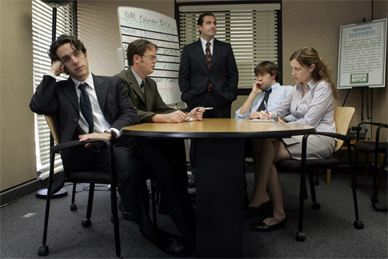
4. Awkward feelings during a coaching
session
Notes:
53

Slide 54
5. Absence of Role Model for Coaching
Notes:
54

Slide 55
6. Number of employees
to contend with
Notes:
55

Slide 56
7. Failure to set initial goals with employee
Notes:
56

Slide 57
In COACHING........
☑ Coaches do a lot of listening and asking Powerful Questions
☑ Powerful Questions –
those that move the Coachee into finding for and by himself the solution to his own concerns, or answer to his/her own quests

Slide 58
In Coaching:
☑ Coaches know that the coachee’s own solutions will always be better than their advice or suggestions

Slide 59
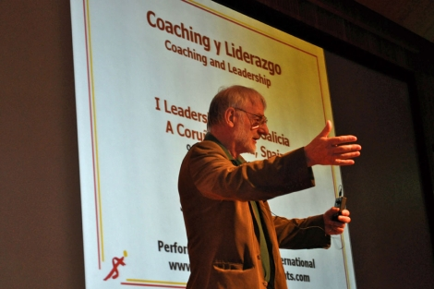
“Coaching is
a way of managing,
a way of treating people, a way of thinking,
a way of being.”
John Whitmore
(Author of Coaching for Performance)
Notes:
59
There are three good definitions of what coaching is by John Whitmore... (read definition)

Slide 60
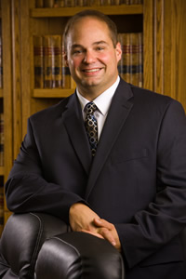
“You can use a coach to
get your personal life together,
to set and reach goals, stand and expand a business,
get ahead faster in business,
improve your job performance and communicate better with everyone”..
Its uses. . . You can use a coach to
get your personal life together,
to set and reach goals,
start and expand a business,
get ahead faster in business,
improve your job performance and communicate better with everyone.
Thomas Leonard
father of modern coaching
Thomas Leonard
(Father of Modern Coaching)
Notes:
60
By Thomas Leonard, Father of Modern Coaching: (read text)

Slide 61
“Leading people where they want to go”
Judy Barber
Notes:
and Judy Barber,

Slide 62
WHO CAN YOU COACH?
Superiors
Subordinates
Peers
External Stakeholders
Anyone can be coached provided they have asked you to be their coach
The best coaching happens when the coach truly believes that the expert is the coachee
Anyone can be coached provided that there is a coaching contract in place
Notes:
Despite these however, there can be coaching even if the coachee is not aware of it. What is the coaching contract mentioned here? When there is meeting of the minds, coachable moment or best when the person approaches you for coaching. As we know, it takes a certain degree of humility for a person to submit one’s self to coaching. The contract may be formal or informal, but is very important.

Slide 63
COACHING
SUBORDINATES AND NON-SUBORDINATES
If managers manage by the principles of coaching – encouraging awareness, responsibility and
independent thinking –
they get the job done to a
higher standard and develop
their people simultaneously.”
- JOHN WHITMORE

Slide 64
Coachability
Those who are uncoachable often think they have no performance issues
Forcing someone into a coaching relationship is not the best organizational solution for certain issues and individuals
Notes:
As a coach, it is our responsibility to create a coachable environment, what we call coachable moment. Why?

Slide 65
CHARACTERISTICS OF CLIENT’S COACHABILITY
COMMITTED TO CHANGE
People-who do not think they are perfect want to improve, exhibit responsibility for their lives and are willing to step outside of their comfort zones-are good candidates

Slide 66
OPEN TO INFORMATION ABOUT THEMSELVES
Being willing and able to explore their own behaviors and learn more about themselves

Slide 67
OPEN ABOUT THEMSELVES
Willing to engage in topics that may be uncomfortable but are getting in the way of their professional development

Slide 68
APPRECIATE NEW PERSPECTIVES
People who get excited about finding new ways of looking at a situation and figuring out how to learn from it can really benefit from coaching

Slide 69
Coachable people already have at least a fair amount of awareness about themselves
They use this awareness to reflect on their behavior and how it impacts other people in the range of situations that come their way

Slide 70
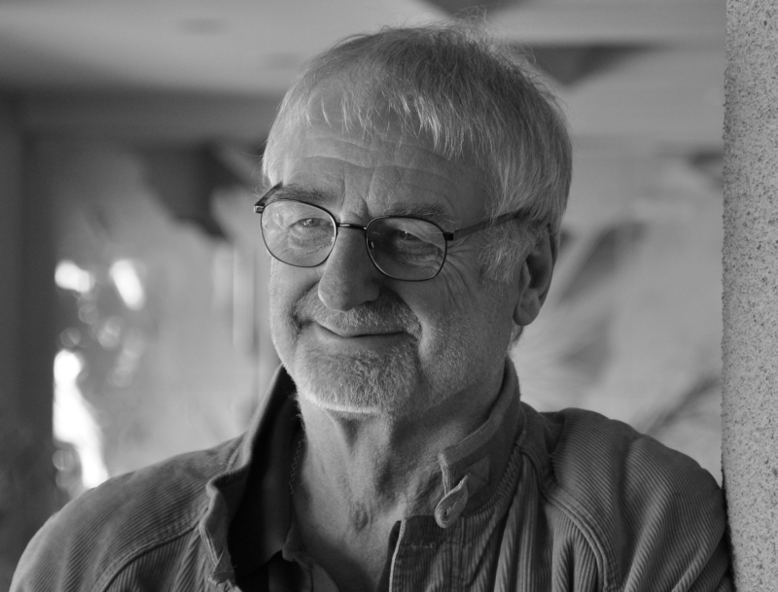
COACHING STRUCTURE
BY JOHN WHITMORE
GROW Model- video
Notes:
70

Slide 71
The GROW Process of Coaching
G
GOAL
Based around the theory that using questions rather than instructions in an organization will foster change more readily
- John Whitmore
R
REALITY
O
OPTIONS
W
WILL
Notes:
71

Slide 72
The GROW Process of Coaching
How do you want your career to progress?
What outcome do you want from this process?
How do you feel this process will help you?
Will this session be sufficient to cover the points you need to cover?
What would it take for this process to be a success?
Notes:
First of the process is establishing or identifying goal or goals.

Slide 73
How do you see your style of management/leadership?
How do you think others view your style of management/style?
Can you provide examples of this?
Notes:
Second of the process is assessing reality. This includes assessing the present state of the person, the strengths, the weaknesses, the problems or challenges that he or she is being confronted to.

Slide 74
OPTIONS
How could the situation change?
How could you improve the situation?
Can you provide some specific options for action?
Are you aware of the possible downsides to those options?
Which of these suggested options would you like to try?
Notes:
Third process is exploring or identifying options. These refer to the opportunities, the possible courses of action that the coachee may consider or take. The repercussions of every option shall likewise be assessed or looked into.

Slide 75
WILL
How can you put these options into action?
Are you aware of any obstacles to these actions?
What further support do you need from your coach?
Does your organization offer in-house support for change?
If not, can you push for an in-house support system?
Can you put this action plan into writing?
Notes:
Will refers to the actions and strategies to be taken or adopted by the coachee.

Slide 76
QUALITIES OF A GOOD COACH
Honest, genuine and authentic
Has a positive view of human nature
Has a positive view of human nature
Wants others to succeed
Can create a thinking environment
Enjoy seeing others develop
Notes:
Being a true coach needs a change of mind set and behavior.

Slide 77
QUALITIES OF A GOOD COACH
Enjoys learning
Wants others to be independent
Generous with appreciation
Values the opinions and initiative of others
Motivates others by setting a good
example
Notes:
Supervisors have usually been expected to guide, advise, instruct and give feedback to improve performance. We are expected to be a better problem solver than our team members. But as a skilled coaches, we need to think and behave quite differently.

Slide 78
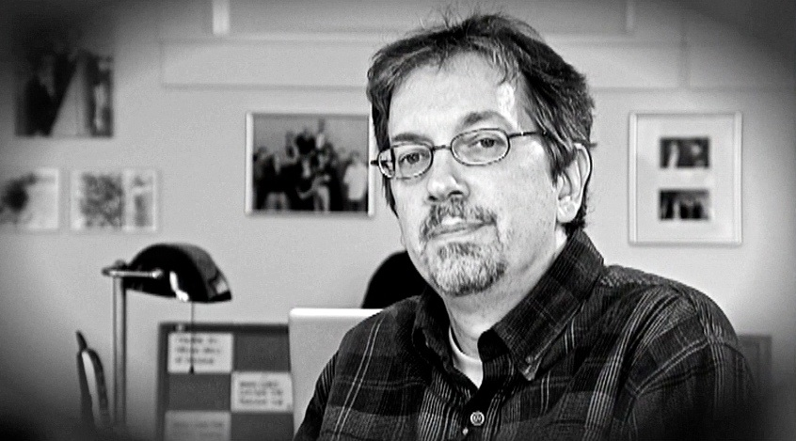
“You get the best effort from others not by lighting a fire beneath them, but by
building the fire
Within him.”
-Bob Nelson
Comedian

Slide 79
"The goal of coaching
is the goal of good management:
to make the most
of an organization's valuable resources.”
-Harvard Business Review

Slide 80
SPMS CYCLE
Notes:
Now it is time to relate what we have learned about coaching to the Strategic Performance Management System requirements.
We all know the PMS Cycle, right?
Stage 1- Performance Planning and Commitment=It is done prior to the start of the performance period where heads of offices meet with the supervisors and staff and agree on the output that should be accomplished based on the goals and objectives of the organization. The suggested time for Performance Planning and Commitment is the last quarter of the preceding year.
Stage 2-Performance Monitoring and Coaching=It is done regularly during the performance period by the Heads of Agency, Planning Office, Division, and Office Heads, and the individual. The focus is creating an enabling environment to improve team performance and develop individual potentials. The suggested time periods are January to June and July to December.
Stage 3- Performance Review and Evaluation=It is done at regular intervals to assess both the performance of the individual and his/her office. The suggested time periods are the first week of July and the first week of January the following year.
Stage 4 -Performance Rewarding and Development Planning=It is based on the results of the performance review and evaluation when appropriate developmental interventions shall be made available to specific employees. The suggested time periods are the first week of July and the first week of January the following year.

Slide 81
SPMS CYCLE
Notes:
Performance Monitoring and Coaching is Stage 2 so this is where our coaching competency should come in.

Slide 82
Stage 2: Performance Monitoring and Coaching
It is done regularly during the performance period
by the Heads of Agency, Planning
Office, Division, and Office Heads,
and the individual.
The focus is creating an enabling environment to improve team performance and develop individual potentials.
The suggested time periods are January to June and July to December

Slide 83
When reviewing Stage 2, ask yourself the following questions:
Are feedback sessions to discuss performance of offices, officials and employees provided in your Agency Guidelines and scheduled in your SPMS calendar?

Slide 84
Are interventions given to those
who are behind work targets? Is
space provided in the Employee
Feedback Form for recommended
interventions?
Is there a form or logbook to record critical incidents, schedule of coaching, and the action plan?

Slide 85
MFO | TASKS | ASSIGNED TO | DURATION | TASK STATUS |  |  |  | REMARKS
Personnel Policies and Standards Services | Prepare Resolutions for accreditation of agencies | Staff A & B | 7 days from receipt by the HRPSO | WEEK 1 | WEEK 2 | WEEK 3 | WEEK 4
 | Draft PRIME-HRM Certifying Board (CB) Standards for Center/Seal of Excellence | Staff B | January to February 15
 | Draft replies to queries | Staff A, B & C | 7 days upon receipt the HRPSO
 | Organize meeting with award-giving bodies | Staff C | EO May
PERFORMANCE MONITORING AND COACHING TOOLS
Notes:
During the monitoring and coaching period, it is important that you regularly monitor the performance of offices, divisions, and employees. You must put monitoring and evaluation mechanisms and tools in place so that timely and appropriate steps can be taken towards meeting performance targets and organizational goals. This requires an information system that supports monitoring and evaluation.

Slide 86
TASK I.D. NO. | SUBJECT | ACTION OFFICER | OUTPUT | DATE ASSIGNED | DATE ACCOMPLISHED |  | REMARKS
Document No. Or Task No. If Taken from WFP | Subject Area of the Task or the Signatory of the Document and Subject |  |  | Date the task was assigned to drafter | Date the Output was approved by the Supervisor
Doc. No. | Signatory | Subject | Action Officer | Date Assigned | Date Signed | Status |  | Remarks
2013-001 | Dir. Juan Dela Cruz, DOLE | Step Increment | ABA | Jan. 2, 2013 | January 4, 2013 | Mailed on Jan. 4, 2013
2013-005 | Ms. Anna Santos | Leave of Barangay Officials | ZMO | Jan. 7, 2013 | Jan. 9, 2013 | Emailed on Jan. 9, 2013 |  | Emailed on Jan. 9, 2013
PERFORMANCE MONITORING AND COACHING TOOLS

Slide 87
SAMPLE PERFORMANCE MONITORING AND COACHING JOURNAL

Slide 88
COACHING REPORT FORM A

Slide 89
COACHING REPORT FORM A

Slide 90
THANK YOU !
DIRECTOR JOCELYN PATRICE L. DECO
Civil Service Commission
QCGUPFO

